Slide 1
Section 6.4 Sine Law
© Copyright all rights reserved to Homework depot: www.BCMath.ca

Slide 2
I) Sine of Supplementary Angles
If Angles “A” and “B” add to 180degrees, then

Slide 3
II) Sine Law
The Sine Law is for solving triangles that are not RT
Name each side with the opposite angle
There are 3 separate equations
The Sine Law can only be used when you are given one of the angles with its opposite side

Slide 4
Ex: Find the value of “x”
Indicate the sides and angles
Formula
Cross Multiply and Solve for “X”

Slide 5
Practice: Find the value of “x”
Indicate the sides and angles
Formula
Cross Multiply and Solve for “X”

Slide 6
III) Finding Missing Angles
To find the angle, you need to use inverse sine
If the angle is obtuse, you need to find the angle in Quadrant #2
Ex: Find the value of “θ” to the nearest degree
Indicate the sides and angles
Formula

Slide 7
Practice: Find θ to the nearest degree
Indicate the sides and angles
Formula
Angle “B” is an OBTUSE angle,
So it must be in Quadrant #2!!

Slide 8
Practice: Find θ to the nearest degree
Indicate the sides and angles
Formula
Angle “B” is an OBTUSE angle,
So it must be in Quadrant #2!!

Slide 9
Ex: The angle of elevation to the top of the tower is 43°. If you travels 100m closer, the angle is 75°. How tall is the tower? Assume the person is about 1.5m tall.
Make a Triangle and Gather Info
Find the Hypotenuse of the triangle
Use the Hypotenuse to find the opposite side
Height of
the Tower

Slide 10
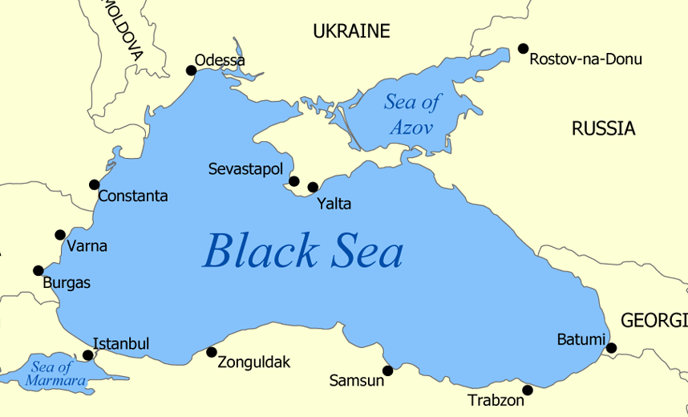
Practice: A ship leaves Batumi on a bearing 300 and sails 860km. They then change direction on a bearing of 222 and sail for 580km and reached Istanbul. How far is Batumi from Istanbul?
Turkey

Slide 11
Angle Bisectors in Triangles
When an angle in a triangle is bisected, the sides of the triangle are also in ratio
Since x+y=90°
Prove the formula by using the
SINE LAW!!

Slide 12
Find the length of “X”

Slide 13
∆ABC has integers side lengths. BD is an angle bisector, with AD=3 and DC=7. What is the smallest possible area of the triangle? AMC10

